Slide 1
Lecture 5 Database Security
modified from slides of Lawrie Brown
Notes:
This chapter looks at the unique security issues that relate to databases.
The focus of this chapter is on relational database management systems
(RDBMS). The relational approach dominates industry, government, and
research sectors and is likely to do so for the foreseeable future. We begin with an
overview of the need for database-specific security techniques. Then we provide
a brief introduction to database management systems, followed by an overview
of relational databases. Next, we look at the issue of database access control,
followed by a discussion of the inference threat. Then we examine security issues
for statistical databases. Next, we examine database encryption. Finally, we
examine the issues raised by the use of cloud technology.

Slide 2
Databases
structured collection of data stored for use by one or more applications
contains the relationships between data items and groups of data items
can sometimes contain sensitive data
database management system (DBMS)
suite of programs for constructing and maintaining the database
ad hoc query facilities to multiple users and applications
provides a uniform interface to the database
Notes:
Organizational databases tend to concentrate sensitive information in a single
logical system. Examples include:
• Corporate financial data
• Confidential phone records
• Customer and employee information, such as name, Social Security number,
bank account information, credit card information
• Proprietary product information
• Health care information and medical records
For many businesses and other organizations, it is important to be able to
provide customers, partners, and employees with access to this information. But such
information can be targeted by internal and external threats of misuse or unauthorized
change. Accordingly, security specifically tailored to databases is an increasingly
important component of an overall organizational security strategy.
In some cases, an organization can function with a relatively simple collection of files of
data. Each file may contain text (e.g., copies of memos and reports) or numerical data
(e.g., spreadsheets). A more elaborate file consists of a set of records. However, for an
organization of any appreciable size, a more complex structure known as a database
is required. A database is a structured collection of data stored for use by one or more
applications. In addition to data, a database contains the relationships between data
items and groups of data items. As an example of the distinction between data files
and a database, consider the following. A simple personnel file might consist of a set
of records, one for each employee. Each record gives the employee’s name, address,
date of birth, position, salary, and other details needed by the personnel department.
A personnel database includes a personnel file, as just described. It may also
include a time and attendance file, showing for each week the hours worked by each
employee. With a database organization, these two files are tied together so that a
payroll program can extract the information about time worked and salary for each
employee to generate paychecks.
Accompanying the database is a database management system (DBMS) ,
which is a suite of programs for constructing and maintaining the database and for
offering ad hoc query facilities to multiple users and applications. A query language
provides a uniform interface to the database for users and applications.

Slide 3
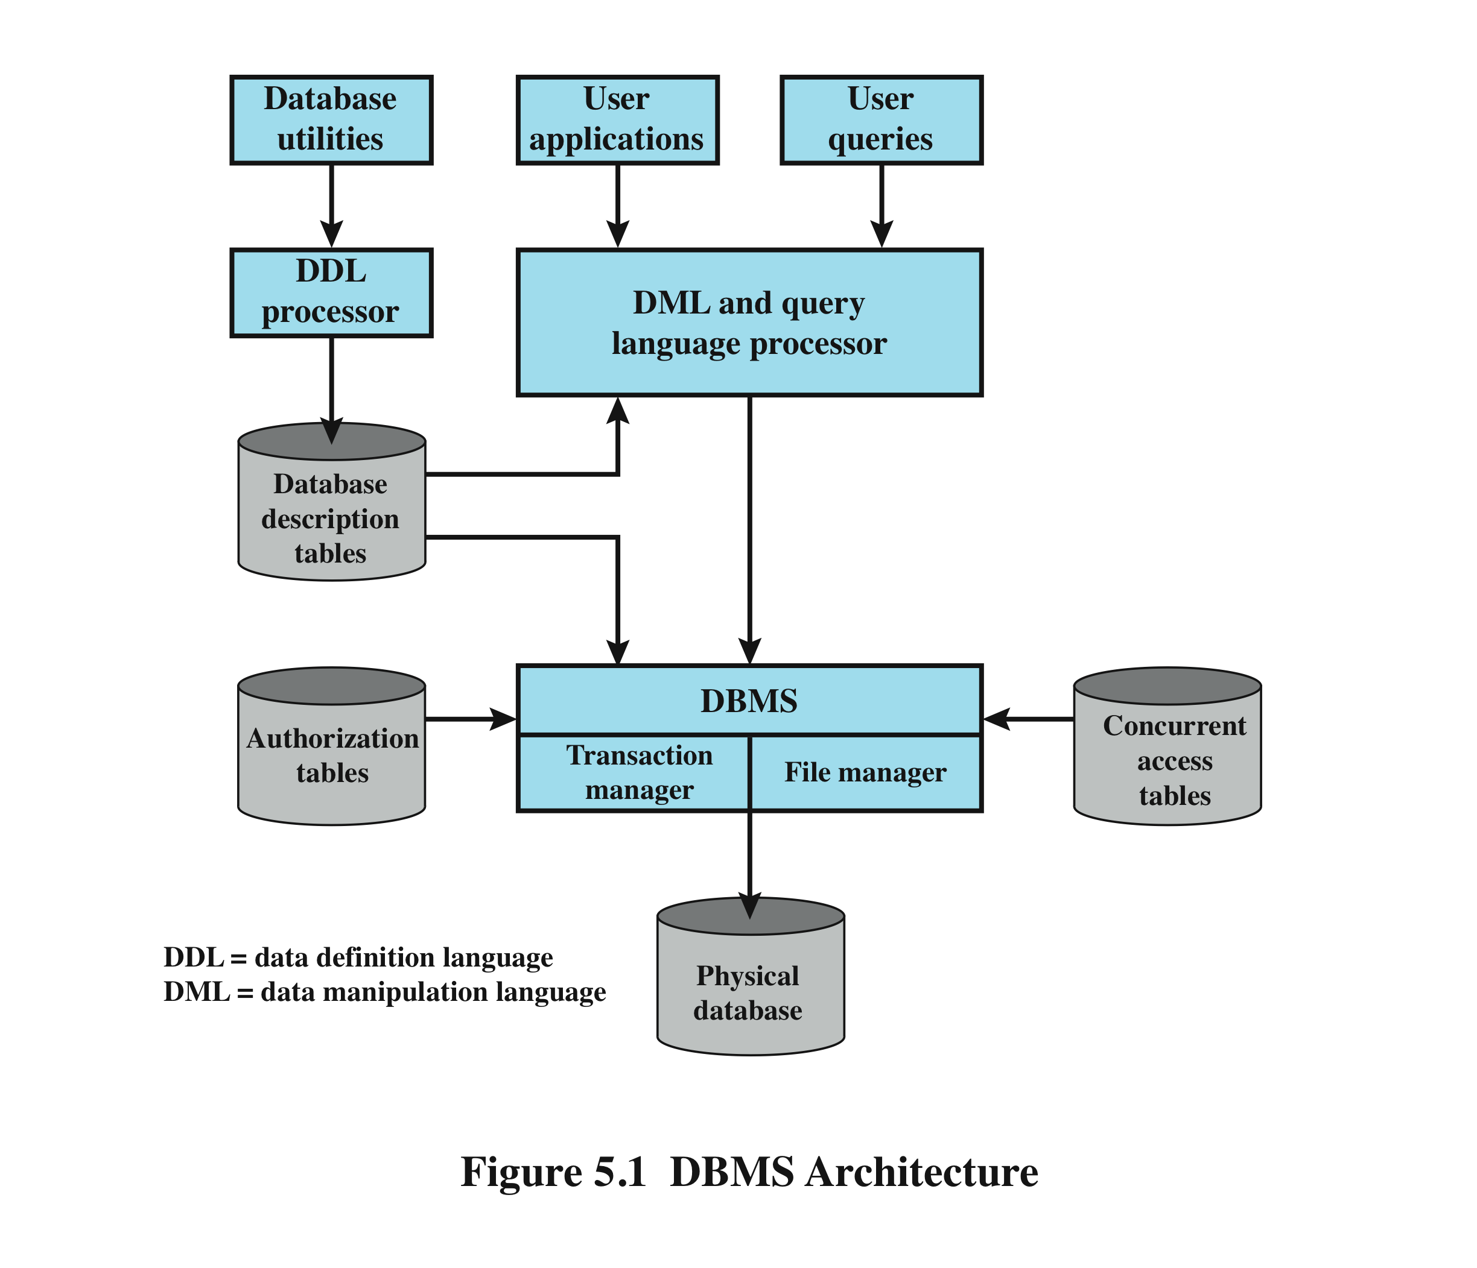
DBMS Architecture
Notes:
Figure 5.1 provides a simplified block diagram of a DBMS architecture. Database
designers and administrators make use of a data definition language (DDL) to define
the database logical structure and procedural properties, which are represented by
a set of database description tables. A data manipulation language (DML) provides
a powerful set of tools for application developers. Query languages are declarative
languages designed to support end users. The database management system makes
use of the database description tables to manage the physical database. The interface
to the database is through a file manager module and a transaction manager module.
In addition to the database description table, two other tables support the DBMS.
The DBMS uses authorization tables to ensure the user has permission to execute
the query language statement on the database. The concurrent access table prevents
conflicts when simultaneous, conflicting commands are executed.
Database systems provide efficient access to large volumes of data and are vital
to the operation of many organizations. Because of their complexity and criticality,
database systems generate security requirements that are beyond the capability of
typical OS-based security mechanisms or stand-alone security packages.
Operating system security mechanisms typically control read and write
access to entire files. So they could be used to allow a user to read or to write any
information in, for example, a personnel file. But they could not be used to limit
access to specific records or fields in that file. A DBMS typically does allow this type
of more detailed access control to be specified. It also usually enables access controls
to be specified over a wider range of commands, such as to select, insert, update, or
delete specified items in the database. Thus, security services and mechanisms are
needed that are designed specifically for, and integrated with, database systems.

Slide 4
Relational Databases
table of data consisting of rows and columns
each column holds a particular type of data
each row contains a specific value for each column
ideally has one column where all values are unique, forming an identifier/key for that row
enables the creation of multiple tables linked together by a unique identifier that is present in all tables
use a relational query language to access the database
request data that fit a given set of criteria
Notes:
The basic building block of a relational database is a table of data, consisting of rows
and columns, similar to a spreadsheet. Each column holds a particular type of data,
while each row contains a specific value for each column. Ideally, the table has at
least one column in which each value is unique, thus serving as an identifier for a
given entry. For example, a typical telephone directory contains one entry for each
subscriber, with columns for name, telephone number, and address. Such a table is
called a flat file because it is a single two-dimensional (rows and columns) file. In a
flat file, all of the data are stored in a single table. For the telephone directory, there
might be a number of subscribers with the same name, but the telephone numbers
should be unique, so that the telephone number serves as a unique identifier for a
row. However, two or more people sharing the same phone number might each be
listed in the directory. To continue to hold all of the data for the telephone directory
in a single table and to provide for a unique identifier for each row, we could require
a separate column for secondary subscriber, tertiary subscriber, and so on. The result
would be that for each telephone number in use, there is a single entry in the table.
The drawback of using a single table is that some of the column positions for
a given row may be blank (not used). Also, any time a new service or new type of
information is incorporated in the database, more columns must be added and the
database and accompanying software must be redesigned and rebuilt.
The relational database structure enables the creation of multiple tables
tied together by a unique identifier that is present in all tables.
Users and applications use a relational query language to access the database.
The query language uses declarative statements rather than the procedural
instructions of a programming language. In essence, the query language allows
the user to request selected items of data from all records that fit a given set of
criteria. The software then figures out how to extract the requested data from one
or more tables. For example, a telephone company representative could retrieve a
subscriber’s billing information as well as the status of special services or the latest
payment received, all displayed on one screen.

Slide 5
Relational Database Elements
relation / table / file
tuple / row / record
attribute / column / field
primary key
uniquely identifies a row
consists of one or more column names
foreign key
links one table to attributes in another
view / virtual table
result of a query that returns selected rows and columns from one or more tables
Notes:
In relational database parlance, the basic building block is a relation , which is a
flat table. Rows are referred to as tuples , and columns are referred to as attributes
A primary key is defined to be a portion of a row used to uniquely
identify a row in a table; the primary key consists of one or more column names.
In the example of Figure 5.2 , a single attribute, PhoneNumber, is sufficient to
uniquely identify a row in a particular table.
To create a relationship between two tables, the attributes that define the
primary key in one table must appear as attributes in another table, where they are
referred to as a foreign key . Whereas the value of a primary key must be unique
for each tuple (row) of its table, a foreign key value can appear multiple times in
a table, so that there is a one-to-many relationship between a row in the table with
the primary key and rows in the table with the foreign key.
A view is a virtual table. In essence, a view is the result of a query that returns
selected rows and columns from one or more tables.
Views are often used for security purposes. A view can provide restricted access to a
relational database so that a user or application only has access to certain rows or columns.

Slide 6
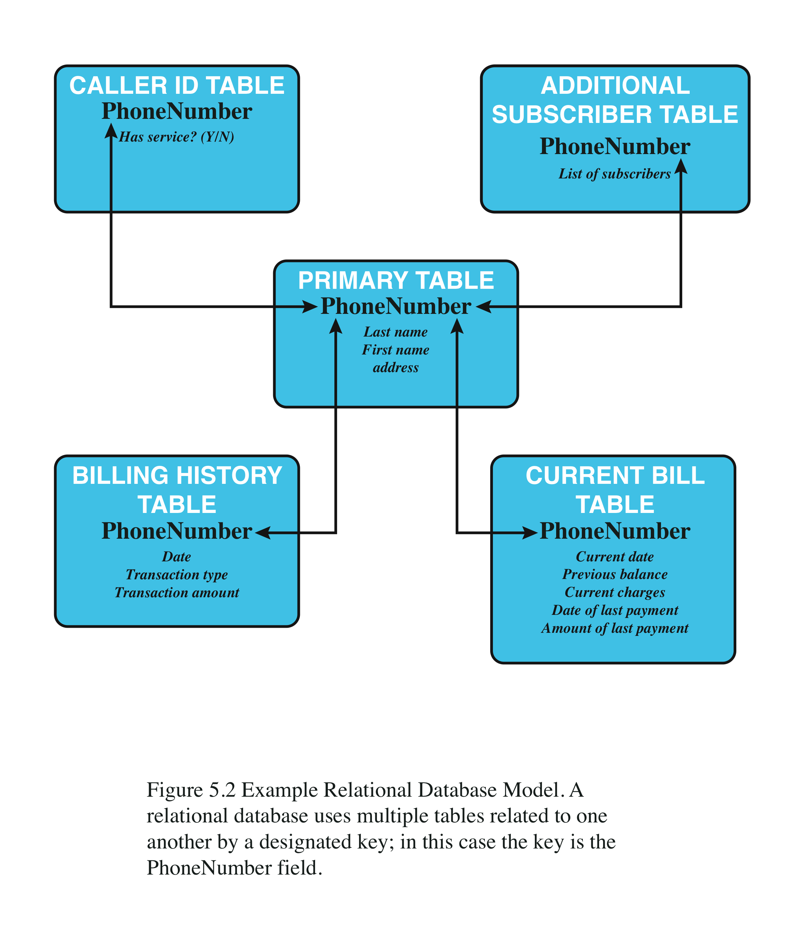
Relational Database Example
Notes:
Figure 5.2 shows
how new services and features can be added to the telephone database without
reconstructing the main table. In this example, there is a primary table with
basic information for each telephone number. The telephone number serves as
a primary key. The database administrator can then define a new table with a
column for the primary key and other columns for other information.

Slide 7
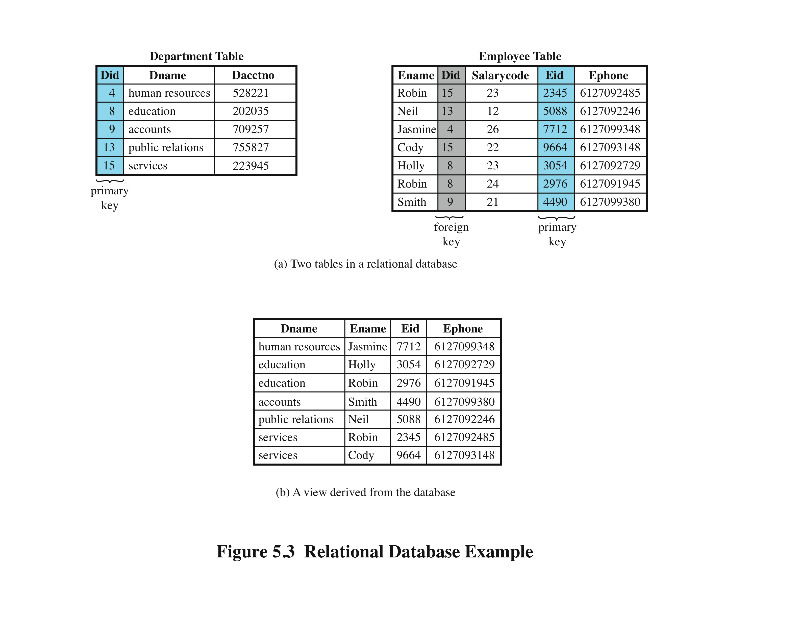
Relational Database Example
SQL statements can be used to extract data from the above table such as
“SELECT * FROM Department”
“SELECT * FROM Employee WHERE Ename=’Neil’ ”
Notes:
Figure 5.3b is a view that
includes the employee name, ID, and phone number from the Employee table and
the corresponding department name from the Department table. The linkage is the
Did , so that the view table includes data from each row of the Employee table, with
additional data from the Department table. It is also possible to construct a view
from a single table. For example, one view of the Employee table consists of all
rows, with the salary code column deleted. A view can be qualified to include only
some rows and/or some columns. For example, a view can be defined consisting of
all rows in the Employee table for which the Did 15.

Slide 8
Structured Query Language (SQL)
originally developed by IBM in the mid-1970s
standardized language to define, manipulate, and query data in a relational database
several similar versions of ANSI/ISO standard
SQL statements can be used to:
create tables
insert and delete data in tables
create views
retrieve data with query statements
Notes:
Structured Query Language (SQL), originally developed by IBM in the mid-1970s, is a
standardized language that can be used to define schema, manipulate, and query data
in a relational database. There are several versions of the ANSI/ISO standard and a
variety of different implementations, but all follow the same basic syntax and semantics.
For example, the two tables in Figure 5.3a are defined as follows:
CREATE TABLE department (
Did INTEGER PRIMARY KEY,
Dname CHAR (30),
Dacctno CHAR (6) )
CREATE TABLE employee (
Ename CHAR (30),
Did INTEGER,
SalaryCode INTEGER,
Eid INTEGER PRIMARY KEY,
Ephone CHAR (10),
FOREIGN KEY (Did) REFERENCES department (Did) )
The basic command for retrieving information is the SELECT statement.
Consider this example:
SELECT Ename, Eid, Ephone
FROM Employee
WHERE Did 15
This query returns the Ename, Eid, and Ephone fields from the Employee
table for all employees assigned to department 15.
The view in Figure 5.3b is created using the following SQL statement:
CREATE VIEW newtable (Dname, Ename, Eid, Ephone)
AS SELECT D.Dname E.Ename, E.Eid, E.Ephone
FROM Department D Employee E
WHERE E.Did D.Did
The preceding are just a few examples of SQL functionality. SQL statements
can be used to create tables, insert and delete data in tables, create views, and
retrieve data with query statements.

Slide 9
SQL Access Controls
two commands for managing access rights:
grant
used to grant one or more access rights or can be used to assign a user to a role
revoke
revokes the access rights
typical access rights are:
select, insert, update, delete, references
Notes:
SQL provides two commands for managing access rights, GRANT and REVOKE.
For different versions of SQL, the syntax is slightly different. In general terms, the
GRANT command has the following syntax: 1
GRANT { privileges | role }
[ON table]
TO { user | role | PUBLIC }
[IDENTIFIED BY password]
[WITH GRANT OPTION]
This command can be used to grant one or more access rights or can be used
to assign a user to a role. For access rights, the command can optionally specify that
it applies only to a specified table. The TO clause specifies the user or role to which
the rights are granted. A PUBLIC value indicates that any user has the specified
access rights. The optional IDENTIFIED BY clause specifies a password that
must be used to revoke the access rights of this GRANT command. The GRANT
OPTION indicates that the grantee can grant this access right to other users, with or
without the grant option.
As a simple example, consider the following statement.
GRANT SELECT ON ANY TABLE TO ricflair
This statement enables user ricflair to query any table in the database.
Different implementations of SQL provide different ranges of access rights.
The following is a typical list:
• Select: Grantee may read entire database; individual tables; or specific
columns in a table.
• Insert: Grantee may insert rows in a table; or insert rows with values for specific
columns in a table.
• Update: Semantics is similar to INSERT.
• Delete: Grantee may delete rows from a table.
• References: Grantee is allowed to define foreign keys in another table that
refer to the specified columns.
The REVOKE command has the following syntax:
REVOKE { privileges | role }
[ON table]
FROM { user | role | PUBLIC }
Thus, the following statement revokes the access rights of the preceding example:
REVOKE SELECT ON ANY TABLE FROM ricflair

Slide 10
Role-Based Access Control (RBAC)
RBAC eases administrative burden and improves security
categories of database users:
application owner
end user
administrator
needs to provide the following capabilities:
create and delete roles
define permissions for a role
assign and cancel assignment of users to roles
Notes:
A role-based access control (RBAC) scheme is a natural fit for database access
control. Unlike a file system associated with a single or a few applications, a
database system often supports dozens of applications. In such an environment,
an individual user may use a variety of applications to perform a variety of tasks,
each of which requires its own set of privileges. It would be poor administrative
practice to simply grant users all of the access rights they require for all the tasks
they perform. RBAC provides a means of easing the administrative burden and
improving security.
In a discretionary access control environment, we can classify database users
in three broad categories:
• Application owner: An end user who owns database objects (tables, columns,
rows) as part of an application. That is, the database objects are generated by
the application or are prepared for use by the application.
End user other than application owner: An end user who operates on database
objects via a particular application but does not own any of the database objects.
• Administrator: User who has administrative responsibility for part or all of the
database.
We can make some general statements about RBAC concerning these
three types of users. An application has associated with it a number of tasks,
with each task requiring specific access rights to portions of the database.
For each task, one or more roles can be defined that specify the needed access
rights. The application owner may assign roles to end users. Administrators are
responsible for more sensitive or general roles, including those having to do
with managing physical and logical database components, such as data files,
users, and security mechanisms. The system needs to be set up to give certain
administrators certain privileges. Administrators in turn can assign users to
administrative-related roles.
A database RBAC facility needs to provide the following capabilities:
• Create and delete roles.
• Define permissions for a role.
• Assign and cancel assignment of users to roles.

Slide 11
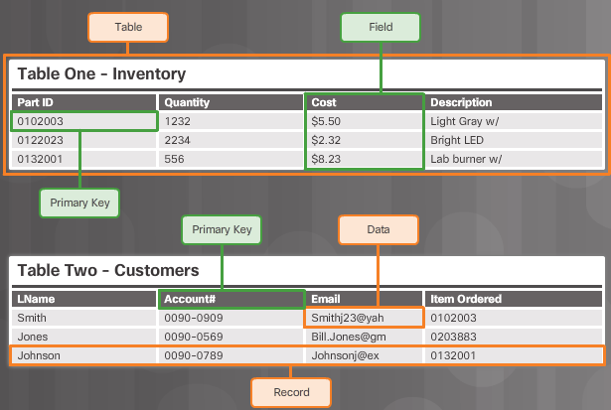
Inferential Integrity
Entity Integrity: All rows must have a unique identifier called a Primary Key
Notes:
A role-based access control (RBAC) scheme is a natural fit for database access
control. Unlike a file system associated with a single or a few applications, a
database system often supports dozens of applications. In such an environment,
an individual user may use a variety of applications to perform a variety of tasks,
each of which requires its own set of privileges. It would be poor administrative
practice to simply grant users all of the access rights they require for all the tasks
they perform. RBAC provides a means of easing the administrative burden and
improving security.
In a discretionary access control environment, we can classify database users
in three broad categories:
• Application owner: An end user who owns database objects (tables, columns,
rows) as part of an application. That is, the database objects are generated by
the application or are prepared for use by the application.
End user other than application owner: An end user who operates on database
objects via a particular application but does not own any of the database objects.
• Administrator: User who has administrative responsibility for part or all of the
database.
We can make some general statements about RBAC concerning these
three types of users. An application has associated with it a number of tasks,
with each task requiring specific access rights to portions of the database.
For each task, one or more roles can be defined that specify the needed access
rights. The application owner may assign roles to end users. Administrators are
responsible for more sensitive or general roles, including those having to do
with managing physical and logical database components, such as data files,
users, and security mechanisms. The system needs to be set up to give certain
administrators certain privileges. Administrators in turn can assign users to
administrative-related roles.
A database RBAC facility needs to provide the following capabilities:
• Create and delete roles.
• Define permissions for a role.
• Assign and cancel assignment of users to roles.

Slide 12
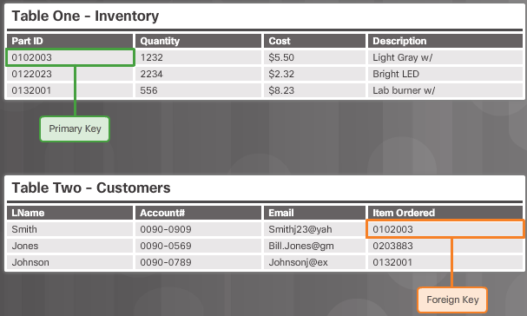
Inferential Integrity
Referential Integrity: Table relationships must remain consistent. Therefore, a user cannot delete a record which is related to another one
Notes:
A role-based access control (RBAC) scheme is a natural fit for database access
control. Unlike a file system associated with a single or a few applications, a
database system often supports dozens of applications. In such an environment,
an individual user may use a variety of applications to perform a variety of tasks,
each of which requires its own set of privileges. It would be poor administrative
practice to simply grant users all of the access rights they require for all the tasks
they perform. RBAC provides a means of easing the administrative burden and
improving security.
In a discretionary access control environment, we can classify database users
in three broad categories:
• Application owner: An end user who owns database objects (tables, columns,
rows) as part of an application. That is, the database objects are generated by
the application or are prepared for use by the application.
End user other than application owner: An end user who operates on database
objects via a particular application but does not own any of the database objects.
• Administrator: User who has administrative responsibility for part or all of the
database.
We can make some general statements about RBAC concerning these
three types of users. An application has associated with it a number of tasks,
with each task requiring specific access rights to portions of the database.
For each task, one or more roles can be defined that specify the needed access
rights. The application owner may assign roles to end users. Administrators are
responsible for more sensitive or general roles, including those having to do
with managing physical and logical database components, such as data files,
users, and security mechanisms. The system needs to be set up to give certain
administrators certain privileges. Administrators in turn can assign users to
administrative-related roles.
A database RBAC facility needs to provide the following capabilities:
• Create and delete roles.
• Define permissions for a role.
• Assign and cancel assignment of users to roles.

Slide 13
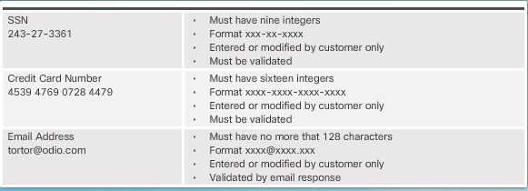
Inferential Integrity
Domain Integrity: All data stored in a column must follow the same format and definition
Notes:
A role-based access control (RBAC) scheme is a natural fit for database access
control. Unlike a file system associated with a single or a few applications, a
database system often supports dozens of applications. In such an environment,
an individual user may use a variety of applications to perform a variety of tasks,
each of which requires its own set of privileges. It would be poor administrative
practice to simply grant users all of the access rights they require for all the tasks
they perform. RBAC provides a means of easing the administrative burden and
improving security.
In a discretionary access control environment, we can classify database users
in three broad categories:
• Application owner: An end user who owns database objects (tables, columns,
rows) as part of an application. That is, the database objects are generated by
the application or are prepared for use by the application.
End user other than application owner: An end user who operates on database
objects via a particular application but does not own any of the database objects.
• Administrator: User who has administrative responsibility for part or all of the
database.
We can make some general statements about RBAC concerning these
three types of users. An application has associated with it a number of tasks,
with each task requiring specific access rights to portions of the database.
For each task, one or more roles can be defined that specify the needed access
rights. The application owner may assign roles to end users. Administrators are
responsible for more sensitive or general roles, including those having to do
with managing physical and logical database components, such as data files,
users, and security mechanisms. The system needs to be set up to give certain
administrators certain privileges. Administrators in turn can assign users to
administrative-related roles.
A database RBAC facility needs to provide the following capabilities:
• Create and delete roles.
• Define permissions for a role.
• Assign and cancel assignment of users to roles.

Slide 14
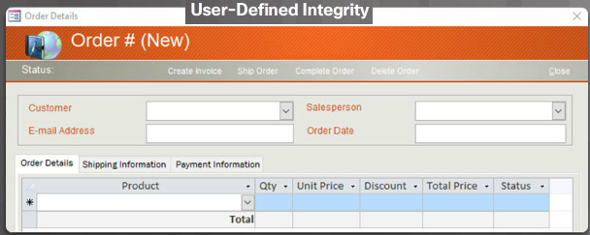
Inferential Integrity
User-defined Integrity: A set of rules defined by a user which does not belong to one of the other categories. For example, a customer places a new order, as shown in Figure 4. The user first checks to see if this is a new customer. If it is, the user adds the new customer to the customers table
Notes:
A role-based access control (RBAC) scheme is a natural fit for database access
control. Unlike a file system associated with a single or a few applications, a
database system often supports dozens of applications. In such an environment,
an individual user may use a variety of applications to perform a variety of tasks,
each of which requires its own set of privileges. It would be poor administrative
practice to simply grant users all of the access rights they require for all the tasks
they perform. RBAC provides a means of easing the administrative burden and
improving security.
In a discretionary access control environment, we can classify database users
in three broad categories:
• Application owner: An end user who owns database objects (tables, columns,
rows) as part of an application. That is, the database objects are generated by
the application or are prepared for use by the application.
End user other than application owner: An end user who operates on database
objects via a particular application but does not own any of the database objects.
• Administrator: User who has administrative responsibility for part or all of the
database.
We can make some general statements about RBAC concerning these
three types of users. An application has associated with it a number of tasks,
with each task requiring specific access rights to portions of the database.
For each task, one or more roles can be defined that specify the needed access
rights. The application owner may assign roles to end users. Administrators are
responsible for more sensitive or general roles, including those having to do
with managing physical and logical database components, such as data files,
users, and security mechanisms. The system needs to be set up to give certain
administrators certain privileges. Administrators in turn can assign users to
administrative-related roles.
A database RBAC facility needs to provide the following capabilities:
• Create and delete roles.
• Define permissions for a role.
• Assign and cancel assignment of users to roles.

Slide 15
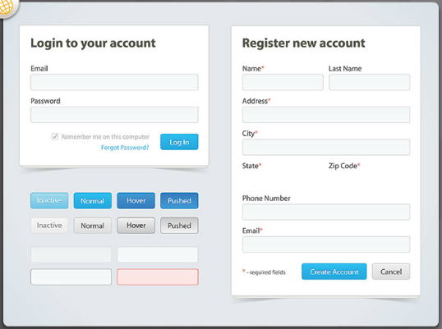
Data Entry Controls
Drop Down Master Data Controls: Have a drop-down option for master tables instead of asking individuals to enter the data. An example of drop down master data controls is using the locations list from the U.S. postal address system to standardize addresses.
Notes:
A role-based access control (RBAC) scheme is a natural fit for database access
control. Unlike a file system associated with a single or a few applications, a
database system often supports dozens of applications. In such an environment,
an individual user may use a variety of applications to perform a variety of tasks,
each of which requires its own set of privileges. It would be poor administrative
practice to simply grant users all of the access rights they require for all the tasks
they perform. RBAC provides a means of easing the administrative burden and
improving security.
In a discretionary access control environment, we can classify database users
in three broad categories:
• Application owner: An end user who owns database objects (tables, columns,
rows) as part of an application. That is, the database objects are generated by
the application or are prepared for use by the application.
End user other than application owner: An end user who operates on database
objects via a particular application but does not own any of the database objects.
• Administrator: User who has administrative responsibility for part or all of the
database.
We can make some general statements about RBAC concerning these
three types of users. An application has associated with it a number of tasks,
with each task requiring specific access rights to portions of the database.
For each task, one or more roles can be defined that specify the needed access
rights. The application owner may assign roles to end users. Administrators are
responsible for more sensitive or general roles, including those having to do
with managing physical and logical database components, such as data files,
users, and security mechanisms. The system needs to be set up to give certain
administrators certain privileges. Administrators in turn can assign users to
administrative-related roles.
A database RBAC facility needs to provide the following capabilities:
• Create and delete roles.
• Define permissions for a role.
• Assign and cancel assignment of users to roles.

Slide 16
Data Entry Controls
Data Field Validation Controls: Set up rules for basic checks including:
Mandatory input ensures that a required field contains data
Input masks prevent users from entering invalid data or help ensure that they enter data consistently (like a phone number, for example)
Positive dollar amounts
Data ranges ensure that a user enters data within a given range (like a date of birth entered as 01-18-1820, for example)
Mandatory second person approval (a bank teller receives a deposit or withdraw request greater than a specified value triggers a second or third approval) .
Maximum record modification trigger (the number of records modified exceeds a predetermined number within a specific period of time blocks a user until a manager identifies whether or not the transactions were legitimate)
Unusual activity trigger (a system locks when it recognizes unusual activity)
Notes:
A role-based access control (RBAC) scheme is a natural fit for database access
control. Unlike a file system associated with a single or a few applications, a
database system often supports dozens of applications. In such an environment,
an individual user may use a variety of applications to perform a variety of tasks,
each of which requires its own set of privileges. It would be poor administrative
practice to simply grant users all of the access rights they require for all the tasks
they perform. RBAC provides a means of easing the administrative burden and
improving security.
In a discretionary access control environment, we can classify database users
in three broad categories:
• Application owner: An end user who owns database objects (tables, columns,
rows) as part of an application. That is, the database objects are generated by
the application or are prepared for use by the application.
End user other than application owner: An end user who operates on database
objects via a particular application but does not own any of the database objects.
• Administrator: User who has administrative responsibility for part or all of the
database.
We can make some general statements about RBAC concerning these
three types of users. An application has associated with it a number of tasks,
with each task requiring specific access rights to portions of the database.
For each task, one or more roles can be defined that specify the needed access
rights. The application owner may assign roles to end users. Administrators are
responsible for more sensitive or general roles, including those having to do
with managing physical and logical database components, such as data files,
users, and security mechanisms. The system needs to be set up to give certain
administrators certain privileges. Administrators in turn can assign users to
administrative-related roles.
A database RBAC facility needs to provide the following capabilities:
• Create and delete roles.
• Define permissions for a role.
• Assign and cancel assignment of users to roles.

Slide 17
Database Validation
A validation rule checks that data falls within the parameters defined by the database designer. A validation rule helps to ensure the completeness, accuracy and consistency of data. The criteria used in a validation rule include the following:
Size – checks the number of characters in a data item
Format – checks that the data conforms to a specified format
Range – checks that data lies within a minimum and maximum value
Check digit – provides for an extra calculation to generate a check digit for error detection
Notes:
A role-based access control (RBAC) scheme is a natural fit for database access
control. Unlike a file system associated with a single or a few applications, a
database system often supports dozens of applications. In such an environment,
an individual user may use a variety of applications to perform a variety of tasks,
each of which requires its own set of privileges. It would be poor administrative
practice to simply grant users all of the access rights they require for all the tasks
they perform. RBAC provides a means of easing the administrative burden and
improving security.
In a discretionary access control environment, we can classify database users
in three broad categories:
• Application owner: An end user who owns database objects (tables, columns,
rows) as part of an application. That is, the database objects are generated by
the application or are prepared for use by the application.
End user other than application owner: An end user who operates on database
objects via a particular application but does not own any of the database objects.
• Administrator: User who has administrative responsibility for part or all of the
database.
We can make some general statements about RBAC concerning these
three types of users. An application has associated with it a number of tasks,
with each task requiring specific access rights to portions of the database.
For each task, one or more roles can be defined that specify the needed access
rights. The application owner may assign roles to end users. Administrators are
responsible for more sensitive or general roles, including those having to do
with managing physical and logical database components, such as data files,
users, and security mechanisms. The system needs to be set up to give certain
administrators certain privileges. Administrators in turn can assign users to
administrative-related roles.
A database RBAC facility needs to provide the following capabilities:
• Create and delete roles.
• Define permissions for a role.
• Assign and cancel assignment of users to roles.

Slide 18
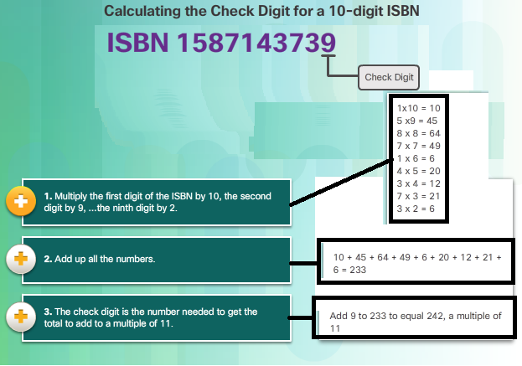
Database Validation(Check Digit)

Slide 19
Database Validation(Check Digit)
Data Type Validation: Verifies that a user entering data is consistent with the type of characters expected.
For example, a phone number would not contain special characters.
Databases allow three data types: integer, string, and decimal
Notes:
A role-based access control (RBAC) scheme is a natural fit for database access
control. Unlike a file system associated with a single or a few applications, a
database system often supports dozens of applications. In such an environment,
an individual user may use a variety of applications to perform a variety of tasks,
each of which requires its own set of privileges. It would be poor administrative
practice to simply grant users all of the access rights they require for all the tasks
they perform. RBAC provides a means of easing the administrative burden and
improving security.
In a discretionary access control environment, we can classify database users
in three broad categories:
• Application owner: An end user who owns database objects (tables, columns,
rows) as part of an application. That is, the database objects are generated by
the application or are prepared for use by the application.
End user other than application owner: An end user who operates on database
objects via a particular application but does not own any of the database objects.
• Administrator: User who has administrative responsibility for part or all of the
database.
We can make some general statements about RBAC concerning these
three types of users. An application has associated with it a number of tasks,
with each task requiring specific access rights to portions of the database.
For each task, one or more roles can be defined that specify the needed access
rights. The application owner may assign roles to end users. Administrators are
responsible for more sensitive or general roles, including those having to do
with managing physical and logical database components, such as data files,
users, and security mechanisms. The system needs to be set up to give certain
administrators certain privileges. Administrators in turn can assign users to
administrative-related roles.
A database RBAC facility needs to provide the following capabilities:
• Create and delete roles.
• Define permissions for a role.
• Assign and cancel assignment of users to roles.

Slide 20
Database Validation(Check Digit)
Input Validation: One of the most vulnerable aspects of database integrity management is controlling the data input process.
Many well-known attacks run against a database and insert malformed data.
The attack can confuse, crash, or make the application divulge too much information to the attacker.
Attackers use automated input attacks.
Notes:
A role-based access control (RBAC) scheme is a natural fit for database access
control. Unlike a file system associated with a single or a few applications, a
database system often supports dozens of applications. In such an environment,
an individual user may use a variety of applications to perform a variety of tasks,
each of which requires its own set of privileges. It would be poor administrative
practice to simply grant users all of the access rights they require for all the tasks
they perform. RBAC provides a means of easing the administrative burden and
improving security.
In a discretionary access control environment, we can classify database users
in three broad categories:
• Application owner: An end user who owns database objects (tables, columns,
rows) as part of an application. That is, the database objects are generated by
the application or are prepared for use by the application.
End user other than application owner: An end user who operates on database
objects via a particular application but does not own any of the database objects.
• Administrator: User who has administrative responsibility for part or all of the
database.
We can make some general statements about RBAC concerning these
three types of users. An application has associated with it a number of tasks,
with each task requiring specific access rights to portions of the database.
For each task, one or more roles can be defined that specify the needed access
rights. The application owner may assign roles to end users. Administrators are
responsible for more sensitive or general roles, including those having to do
with managing physical and logical database components, such as data files,
users, and security mechanisms. The system needs to be set up to give certain
administrators certain privileges. Administrators in turn can assign users to
administrative-related roles.
A database RBAC facility needs to provide the following capabilities:
• Create and delete roles.
• Define permissions for a role.
• Assign and cancel assignment of users to roles.

Slide 21
Database Validation(Check Digit)
Anomaly Verification: Anomaly detection refers to identifying patterns in data that do not conform to expected behavior.
An example of this is a credit card with two transactions in vastly different request locations in a short time. If a transaction request from New York City occurs at 10:30 a.m. and a second request comes from Chicago at 10:35 a.m., the system triggers a verification of the second transaction.
Notes:
A role-based access control (RBAC) scheme is a natural fit for database access
control. Unlike a file system associated with a single or a few applications, a
database system often supports dozens of applications. In such an environment,
an individual user may use a variety of applications to perform a variety of tasks,
each of which requires its own set of privileges. It would be poor administrative
practice to simply grant users all of the access rights they require for all the tasks
they perform. RBAC provides a means of easing the administrative burden and
improving security.
In a discretionary access control environment, we can classify database users
in three broad categories:
• Application owner: An end user who owns database objects (tables, columns,
rows) as part of an application. That is, the database objects are generated by
the application or are prepared for use by the application.
End user other than application owner: An end user who operates on database
objects via a particular application but does not own any of the database objects.
• Administrator: User who has administrative responsibility for part or all of the
database.
We can make some general statements about RBAC concerning these
three types of users. An application has associated with it a number of tasks,
with each task requiring specific access rights to portions of the database.
For each task, one or more roles can be defined that specify the needed access
rights. The application owner may assign roles to end users. Administrators are
responsible for more sensitive or general roles, including those having to do
with managing physical and logical database components, such as data files,
users, and security mechanisms. The system needs to be set up to give certain
administrators certain privileges. Administrators in turn can assign users to
administrative-related roles.
A database RBAC facility needs to provide the following capabilities:
• Create and delete roles.
• Define permissions for a role.
• Assign and cancel assignment of users to roles.

Slide 22
SQL Injection
queries using the SELECT statement to retrieve data, based on user-provided parameters
SELECT ItemName, ItemDescription FROM Item WHERE ItemNumber = ItemNumber
From this, the web application builds a string query that is sent to the database as a single SQL statement:
sql_query= "SELECT ItemName, ItemDescription FROM Item WHERE ItemNumber = " & Request.QueryString("ItemID")”
A user-provided input http://www.estore.com/items/items.asp?itemid=999 can then generates the following SQL query:
SELECT ItemName, ItemDescription FROM Item WHERE ItemNumber = 999
Notes:
Inference, as it relates to database security, is the process of performing authorized
queries and deducing unauthorized information from the legitimate responses
received. The inference problem arises when the combination of a number of
data items is more sensitive than the individual items, or when a combination of
data items can be used to infer data of a higher sensitivity. Figure 5.5 illustrates
the process. The attacker may make use of nonsensitive data as well as metadata.
Metadata refers to knowledge about correlations or dependencies among data
items that can be used to deduce information not otherwise available to a
particular user. The information transfer path by which unauthorized data is
obtained is referred to as an inference channel .

Slide 23
SQL Injection
Example 1 (Invalidated Input): the above-mentioned input, which pulls information for a specific product, can be altered to read http://www.estore.com/items/items.asp?itemid=999 or 1=1.
As a result, the corresponding SQL query looks like this:
SELECT ItemName, ItemDescription FROM Items WHERE ItemNumber = 999 OR 1=1
Notes:
Inference, as it relates to database security, is the process of performing authorized
queries and deducing unauthorized information from the legitimate responses
received. The inference problem arises when the combination of a number of
data items is more sensitive than the individual items, or when a combination of
data items can be used to infer data of a higher sensitivity. Figure 5.5 illustrates
the process. The attacker may make use of nonsensitive data as well as metadata.
Metadata refers to knowledge about correlations or dependencies among data
items that can be used to deduce information not otherwise available to a
particular user. The information transfer path by which unauthorized data is
obtained is referred to as an inference channel .

Slide 24
SQL Injection
Example 2 (Non-Filtered Characters): Attackers are also able to take advantage of incorrectly filtered characters to alter SQL commands,
SELECT ItemName, ItemDescription FROM Items WHERE ItemNumber = 999; DROP TABLE USERS
Notes:
Inference, as it relates to database security, is the process of performing authorized
queries and deducing unauthorized information from the legitimate responses
received. The inference problem arises when the combination of a number of
data items is more sensitive than the individual items, or when a combination of
data items can be used to infer data of a higher sensitivity. Figure 5.5 illustrates
the process. The attacker may make use of nonsensitive data as well as metadata.
Metadata refers to knowledge about correlations or dependencies among data
items that can be used to deduce information not otherwise available to a
particular user. The information transfer path by which unauthorized data is
obtained is referred to as an inference channel .

Slide 25
SQL Injection
Example 3 (Union SELECT): Another way SQL queries can be manipulated is with a UNION SELECT statement. This combines two unrelated SELECT queries to retrieve data from different database tables.
SELECT ItemName, ItemDescription FROM Items WHERE ItemID = '999' UNION SELECT Username, Password FROM Users; FROM Users;
Notes:
Inference, as it relates to database security, is the process of performing authorized
queries and deducing unauthorized information from the legitimate responses
received. The inference problem arises when the combination of a number of
data items is more sensitive than the individual items, or when a combination of
data items can be used to infer data of a higher sensitivity. Figure 5.5 illustrates
the process. The attacker may make use of nonsensitive data as well as metadata.
Metadata refers to knowledge about correlations or dependencies among data
items that can be used to deduce information not otherwise available to a
particular user. The information transfer path by which unauthorized data is
obtained is referred to as an inference channel .

Slide 26
SQL Injection
Countermeasures
Input Validation: While input validation should always be considered best practice, it is rarely a foolproof solution. The reality is that, in most cases, it is simply not feasible to map out all legal and illegal inputs.
Web Application Firewall (WAF): Because all invalid inputs can’t be expected, a web application firewall (WAF) is commonly employed to filter out SQL Injection
Notes:
Inference, as it relates to database security, is the process of performing authorized
queries and deducing unauthorized information from the legitimate responses
received. The inference problem arises when the combination of a number of
data items is more sensitive than the individual items, or when a combination of
data items can be used to infer data of a higher sensitivity. Figure 5.5 illustrates
the process. The attacker may make use of nonsensitive data as well as metadata.
Metadata refers to knowledge about correlations or dependencies among data
items that can be used to deduce information not otherwise available to a
particular user. The information transfer path by which unauthorized data is
obtained is referred to as an inference channel .

Slide 27
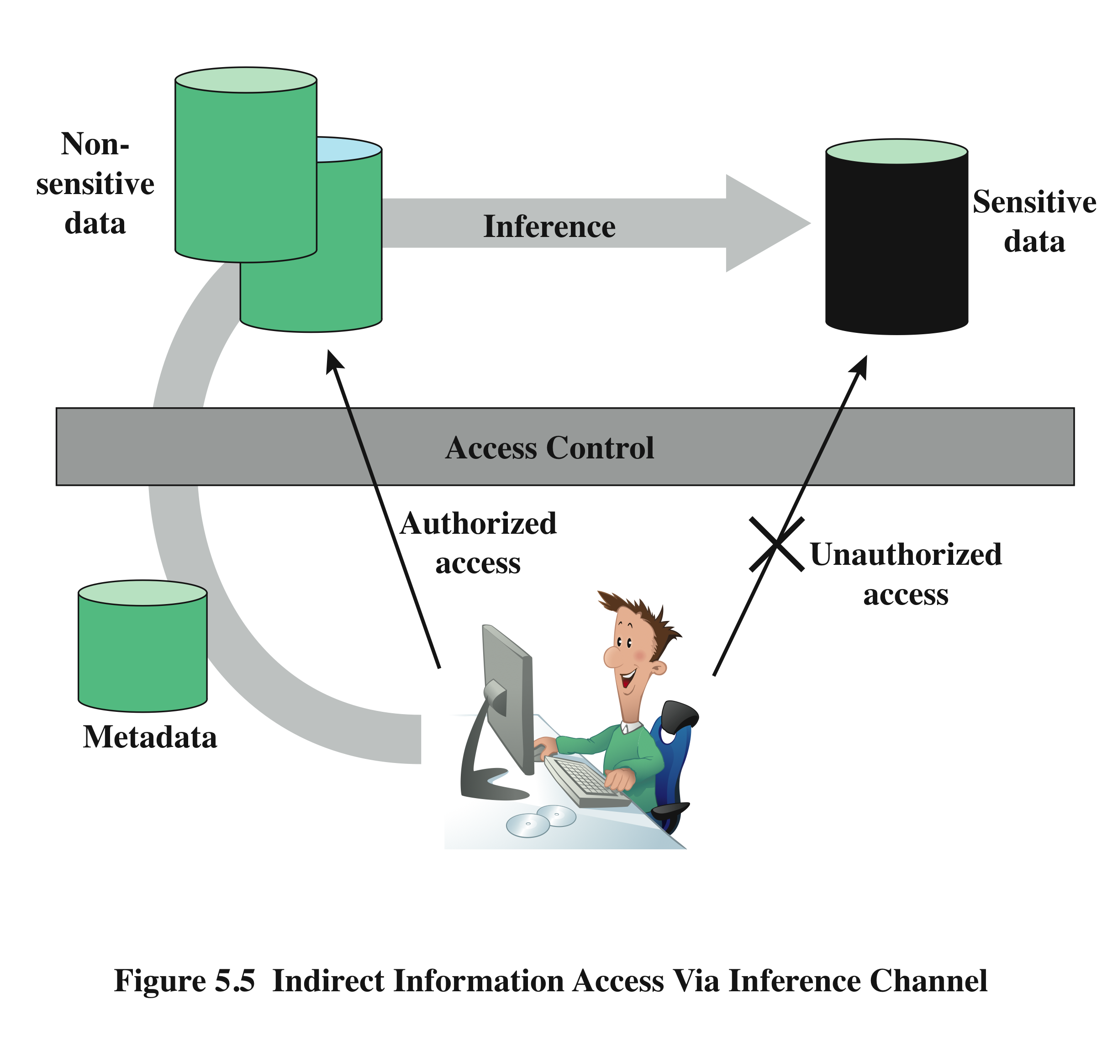
Inference
Performing queries to deduce unauthorized information from the legitimate responses received
inference channel
information transfer path by which unauthorized data is obtained
Notes:
Inference, as it relates to database security, is the process of performing authorized
queries and deducing unauthorized information from the legitimate responses
received. The inference problem arises when the combination of a number of
data items is more sensitive than the individual items, or when a combination of
data items can be used to infer data of a higher sensitivity. Figure 5.5 illustrates
the process. The attacker may make use of nonsensitive data as well as metadata.
Metadata refers to knowledge about correlations or dependencies among data
items that can be used to deduce information not otherwise available to a
particular user. The information transfer path by which unauthorized data is
obtained is referred to as an inference channel .

Slide 28
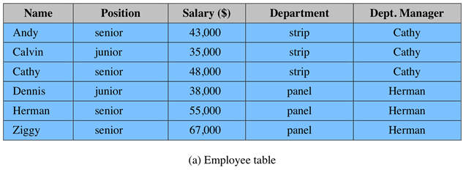
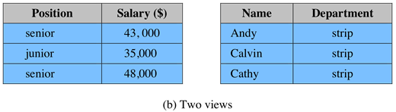
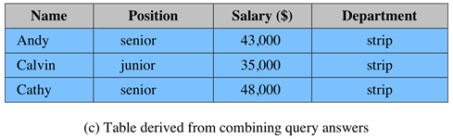
Inference Example
Table (c) can be inferred from views in (b)
On solution to this problem is to separate Employee table into 3 tables
Employees(Emp#, Name, Address)
Salaries(S#, Salary)
Emp-Salary(Emp#, S#)
So the association of names and salaries are disconnected
Notes:
In general terms, two inference techniques can be used to derive additional
information: analyzing functional dependencies between attributes within a table
or across tables, and merging views with the same constraints.
An example of the latter from [SHIE98], shown in Figure 5.6 , illustrates
the inference problem. Figure 5.6a shows an Employee table with five columns.
Figure 5.6b shows two views, defined in SQL as follows:
CREATE view V1 AS CREATE view V2 AS
SELECT Position, Salary SELECT Name, Department
FROM Employee FROM Employee
WHERE Department ”strip” WHERE Department ”strip”
Users of these views are not authorized to access the relationship between
Name and Salary. A user who has access to either or both views cannot infer
the relationship by functional dependencies. That is, there is not a functional
relationship between Name and Salary such that knowing Name and perhaps
other information is sufficient to deduce Salary. However, suppose the two views
are created with the access constraint that Name and Salary cannot be accessed
together. A user who knows the structure of the Employee table and who knows
that the view tables maintain the same row order as the Employee table is then
able to merge the two views to construct the table shown in Figure 5.6c . This
violates the access control policy that the relationship of attributes Name and
Salary must not be disclosed.

Slide 29
Statistical Databases (SDB)
provides data of a statistical nature such as counts and averages
pure statistical database such as census databases
ordinary database with statistical access
access control objective
provide users with the needed information
without compromising the confidentiality
security problem is one of inference
Notes:
A statistical database (SDB) is one that provides data of a statistical nature, such as
counts and averages. The term statistical database is used in two contexts:
• Pure statistical database: This type of database only stores statistical data.
An example is a census database. Typically, access control for a pure SDB is
straightforward: certain users are authorized to access the entire database.
• Ordinary database with statistical access: This type of database contains individual
entries; this is the type of database discussed so far in this chapter. The database
supports a population of nonstatistical users who are allowed access to selected
portions of the database using discretionary access control (DAC), role-based
access control (RBAC), or mandatory access control (MAC). In addition, the
database supports a set of statistical users who are only permitted statistical
queries. For these latter users, aggregate statistics based on the underlying raw
data are generated in response to a user query, or may be precalculated and stored
as part of the database.
For the purposes of this section, we are concerned only with the latter type
of database and, for convenience, refer to this as an SDB. The access control
objective for an SDB system is to provide users with the aggregate information
without compromising the confidentiality of any individual entity represented in
the database. The security problem is one of inference. The database administrator
must prevent, or at least detect, the database user who attempts to gain individual
information through one or a series of statistical queries.

Slide 30
Statistical Database Security
use a characteristic formula C
a logical formula over the values of attributes
e.g. (Sex=Male) AND ((Major=CS) OR (Major=EE))
query set X(C) of characteristic formula C, is the set of records matching C
a statistical query is a query that produces a value calculated over a query set
Notes:
Statistics are derived from a database by means of a characteristic formula
(sometimes referred to as a Boolean formula), C , which is a logical formula over
the values of attributes. A characteristic formula uses the operators OR, AND, and
NOT (, •, ~), written here in order of increasing priority. A characteristic formula
specifies a subset of the records in the database. For example, the formula
( Sex Male) • (( Major CS) ( Major EE))
specifies all male students majoring in either CS or EE. For numerical attributes,
relational operators may be used. For example, ( GP > 3.7) specifies all students
whose grade point average exceeds 3.7. For simplicity, we omit attribute names when
they are clear from context. Thus, the preceding formula becomes Male • (CS EE).
The query set of characteristic formula C , denoted as X( C ), is the set of records
matching that characteristic. For example, for C Female • CS, X( C ) consists of
records 1 and 4, the records for Allen and Davis.

Slide 31
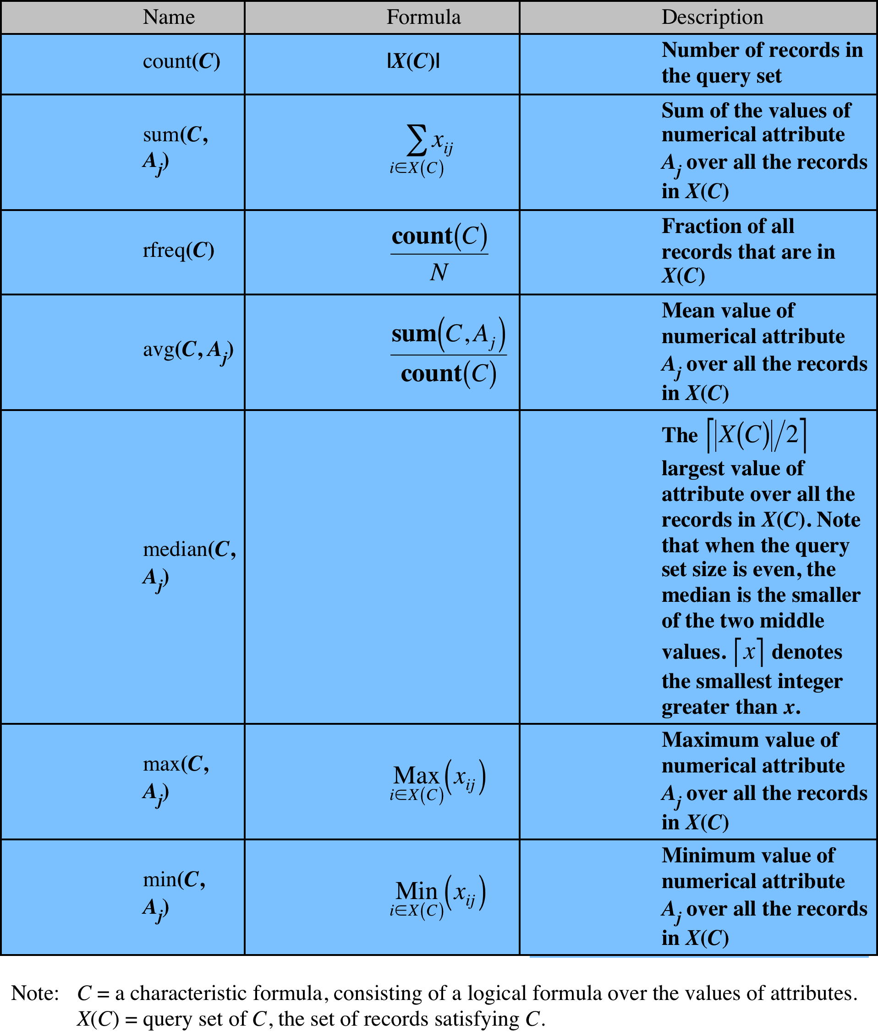
Some Queries of a Statistical Database
Notes:
A statistical query is a query that produces a value calculated over a query set.
Table 5.4 lists some simple statistics that can be derived from a query set. Examples:
count (Female • CS) 2; sum (Female • CS, SAT) 1400.

Slide 32
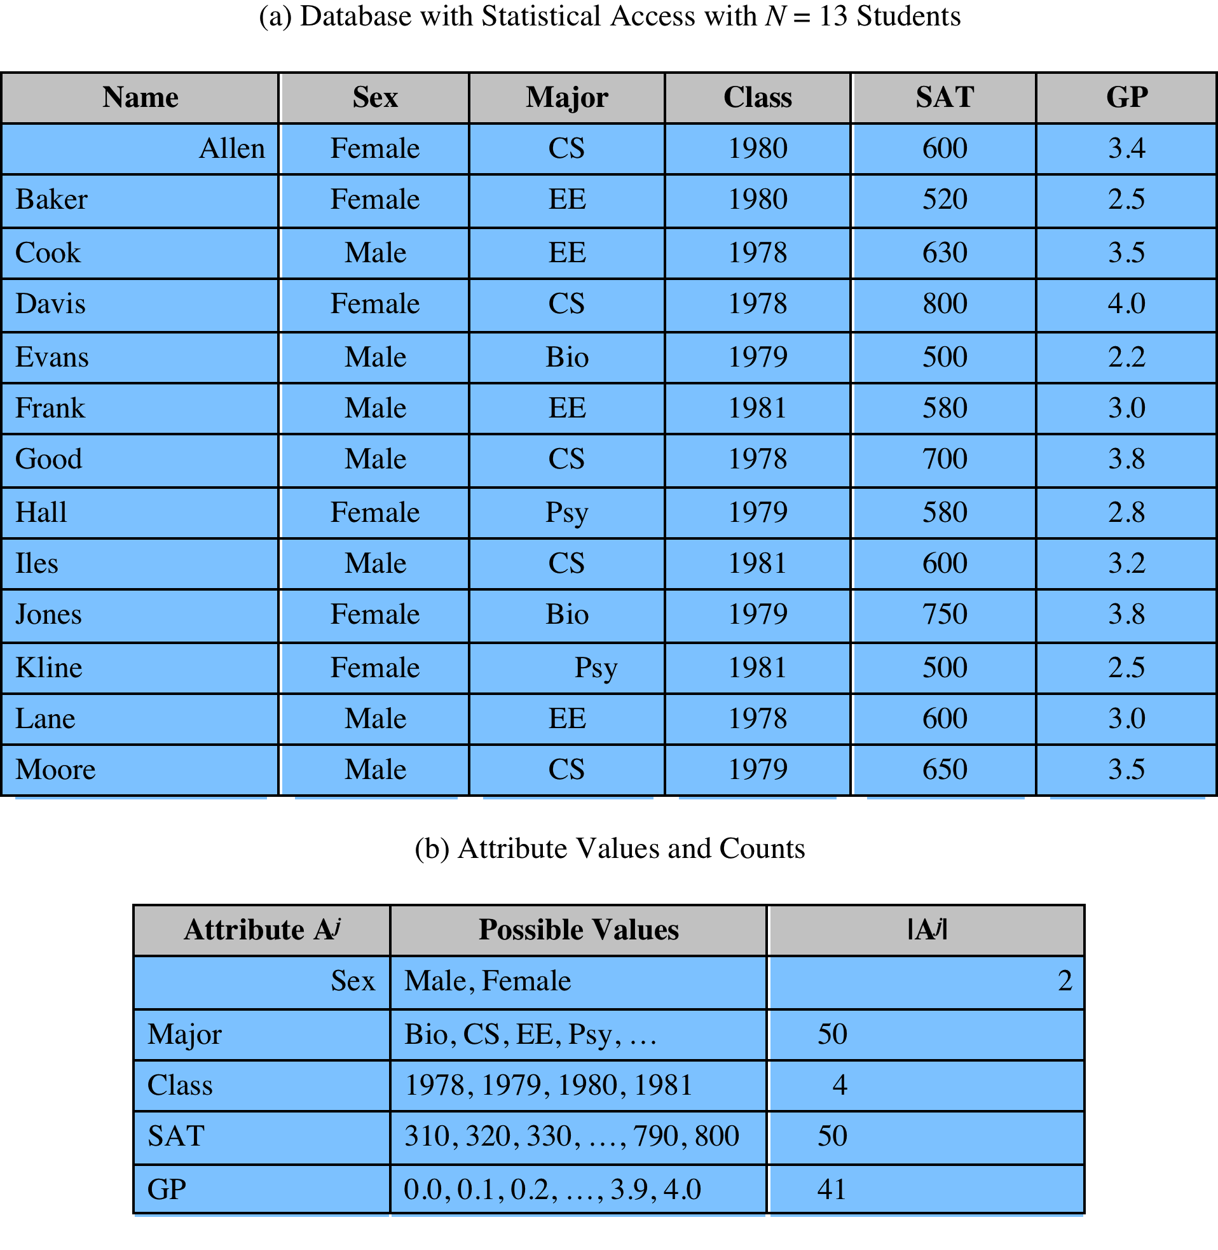
Statistical Database Example
Sum ( EE.Female , GP ) = 2.5 comprises the database if the user knows that Baker is the only female EE student.
Notes:
The example is a database containing 13 confidential
records of students in a university that has 50 departments.

Slide 33
Inference attack
a sequence of queries may reveal information. a questioner knows that Baker is a female EE student but does not know if she is the only one.
count (EE • Female) = 1
sum (EE • Female, GP) = 2.5
This sequence reveals the sensitive information.
Suppose a questioner knows the following information:
Salary range for a new systems analyst with a BS degree is $[50K, 60K]
Salary range for a new systems analyst with a MS degree is $[60K, 70K]
Suppose two new systems analysts are added to the payroll and the change in the sum of the salaries is $130K. Then the questioner knows that both new employees have an MS degree.

Slide 34
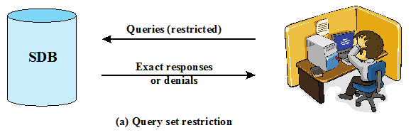
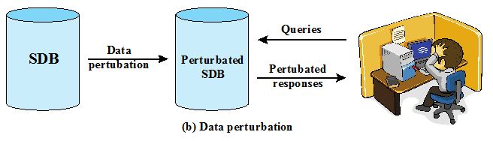
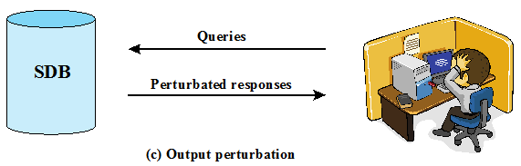
Protecting Against Inference
Two distinct approaches
Query restriction - Query Size Restriction - Query Set Overlap Control - Partitioning - Query Denial and Information Leakage
Perturbation - Data Perturbation - Output perturbation
Notes:
SDB implementers have developed two distinct approaches to protection of an
SDB from inference attacks ( Figure 5.8 ):
• Query restriction: Rejects a query that can lead to a compromise. The answers
provided are accurate.
• Perturbation: Provides answers to all queries, but the answers are approximate.
We examine query restriction in this section and perturbation in the next.
Query restriction techniques defend against inference by restricting statistical
queries so that they do not reveal user confidential information. Restriction in this
context simply means that some queries are denied.

Slide 35
Other Query Restrictions
query set overlap control
limit overlap between new and previous queries
partitioning
cluster records into a number of mutually exclusive groups
query the statistical properties of each group as a whole
query denial and information leakage
denials can leak information( Ex. Sum(x1,x2,x3)=15, max(x1,x2,x3) denied since result not > 5 is restriction). Then it is clear that x1=x2=x3
to counter, must track queries from user
Notes:
A number of other query restriction approaches have been studied, all of which have their own vulnerabilities. However, several of these techniques in combination do reduce vulnerability.
A query size restriction is defeated by issuing queries in which there is considerable overlap in the query sets. To counter this, query set overlap control limits queries from a user so that any new query combined with any previous queries spans less than some limited number of records. This technique has a number of problems: it is ineffective for preventing the cooperation of several users to compromise the database; statistics for both a set and its subset (e.g. all patients and all patients undergoing treatment) cannot be released, thus limiting the usefulness of the database; and for each user, a user profile has to be kept up to date.
Partitioning can be viewed as taking query set overlap control to its logical extreme, by not allowing overlapping queries at all. With partitioning, the records in the database are clustered into a number of mutually exclusive groups, e.g. values for a given year. The user may only query the statistical properties of each group as a whole. Partitioning solves some security problems, but has some drawbacks. The users ability to extract useful statistics is reduced, and there is a design effort in constructing and maintaining the partitions.
A general problem with query restriction techniques is that the denial of a query may provide sufficient clues that an attacker can deduce/leak underlying information. In an approach to counter this threat, the system monitors all queries from a given source and decides on the basis of the queries so far posed whether to deny a new query. The decision is based solely on the history of queries and answers and the new query.

Slide 36
Perturbation
data perturbation technique
data swapping
generate statistics from probability distribution
output perturbation technique
statistic adjustment
random-sample query
goal is to minimize the differences between original results and perturbed results
challenge is to determine the average size of the error to be used
Notes:
Query restriction techniques can be costly and are difficult to implement in such a
way as to completely thwart inference attacks, especially if a user has supplementary
knowledge. For larger databases, a simpler and more effective technique is to, in
effect, add noise to the statistics generated from the original data. This can be done
in one of two ways ( Figure 5.8 ): the data in the SDB can be modified (perturbed)
so as to produce statistics that cannot be used to infer values for individual records;
we refer to this as data perturbation . Alternatively, when a statistical query is made,
the system can generate statistics that are modified from those that the original
database would provide, again thwarting attempts to gain knowledge of individual
records; this is referred to as output perturbation .
Regardless of the specific perturbation technique, the designer must attempt
to produce statistics that accurately reflect the underlying database. Because of
the perturbation, there will be differences between perturbed results and ordinary
results from the database. However, the goal is to minimize the differences and to
provide users with consistent results.
As with query restriction, there are a number of perturbation techniques.
In this section, we highlight a few of these.
A simple output perturbation technique is
known as random-sample query . This technique is suitable for large databases and
is similar to a technique employed by the U.S. Census Bureau. The technique works
as follows:
1. A user issues a query q ( C ) that is to return a statistical value. The query set so
defined is X ( C ).
2. The system replaces X ( C ) with a sampled query set, which is a properly
selected subset of X ( C ).
3. The system calculates the requested statistic on the sampled query set and
returns the value.
Other approaches to output perturbation involve calculating the statistic on
the requested query set and then adjusting the answer up or down by a given amount
in some systematic or randomized fashion. All of these techniques are designed to
thwart tracker attacks and other attacks that can be made against query restriction
techniques.
With all of the perturbation techniques, there is a potential loss of accuracy as
well as the potential for a systematic bias in the results.
The main challenge in the use of
perturbation techniques is to determine the average size of the error to be used.
If there is too little error, a user can infer close approximations to protected values.
If the error is, on average, too great, the resulting statistics may be unusable.
For a small database, it is difficult to add sufficient perturbation to hide data
without badly distorting the results. Fortunately, as the size of the database grows, the
effectiveness of perturbation techniques increases. This is a complex topic, beyond
the scope of this chapter. Examples of recent work include [DWOR06], [EVFI03],
and [DINU03].
The last-mentioned reference reported the following result. Assume the size
of the database, in terms of the number of data items or records, is n . If the number
of queries from a given source is linear to the size of the database (i.e., on the order
of n ), then a substantial amount of noise must be added to the system, in terms of
perturbation, to preserve confidentiality. Specifically, suppose the perturbation is
imposed on the system by adding a random amount of perturbation x . Then,
if the query magnitude is linear, the perturbation must be at least of order 1n .
This amount of noise may be sufficient to make the database effectively unusable.
However, if the number of queries is sublinear (e.g., of order 1n ), then much less
noise must be added to the system to maintain privacy. For a large database, limiting
queries to a sublinear number may be reasonable.

Slide 37

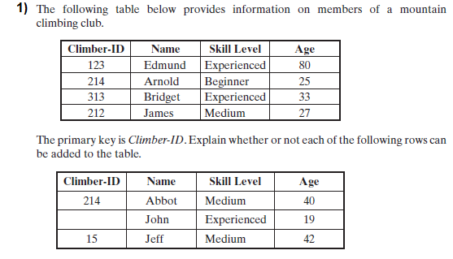
Homework
Notes:
Chapter 5 summary.

Slide 38
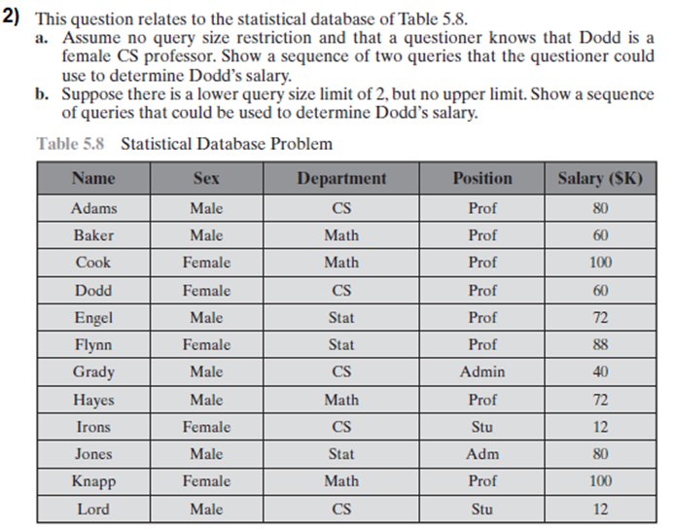
Homework
Notes:
Chapter 5 summary.

